Slide 1
Partitioned Elias-Fano Indexes
Giuseppe Ottaviano | Rossano Venturini
ISTI-CNR, Pisa | Università di Pisa

Slide 2
Inverted indexes
Docid
Document
a | 2, 3
banana | 3
is | 1, 2, 3
it | 1, 3
not | 1
what | 1, 2
Posting list
  1: [it is what it is not]
  2: [what is a]
  3: [it is a banana]
Core data structure of Information Retrieval
We seek fast and space-efficient encoding of posting lists (index compression)

Slide 3
Sequences in posting lists
Generally, a posting lists is composed of
  Sequence of docids: strictly monotonic
  Sequence of frequencies/scores: strictly positive
  Sequence of positions: concatenation of strictly monotonic lists
  Additional occurrence data: ???
We focus on docids and frequencies

Slide 4
Sequences
Elias Fano!
Interpolative coding
Monotonic |  | Strictly monotonic
Non-negative |  | Strictly non-negative (Positive)
Docids
a_{i} + i
a_{i} – a_{i - 1}
Scores
a_{i} - 1
Gap coding

Slide 5
Elias-Fano encoding
Data structure from the ’70s, mostly in the succinct data structures niche
Natural encoding of monotonically increasing sequences of integers
Recently successfully applied to inverted indexes [Vigna, WSDM13]
  Used by Facebook Graph Search!

Slide 6
Elias-Fano representation
Example: 2, 3, 5, 7, 11, 13, 24
w – l upper bits
00010
00011
00101
00111
01011
01101
11000
Count in unary the size of upper bits “buckets”
including empty ones
000
11011010100010
Concatenate lower bits
001
10110111110100
010
011
1101101010001010110111110100
100
101
Elias-Fano representation of the sequence
110
l lower bits

Slide 7
Elias-Fano representation
Example: 2, 3, 5, 7, 11, 13, 24
w – l upper bits
00010
00011
00101
00111
01011
01101
11000
1101101010001010110111110100
Elias-Fano representation of the sequence
n: sequence length
U: largest sequence value
Maximum bucket: [U / 2^{l}]
Example: [24 / 2²] = 6 = 110
Upper bits: one 0 per bucket and one 1 per value
Space
[U / 2^{l}] + n + nl bits
l lower bits

Slide 8
Elias-Fano representation
Example: 2, 3, 5, 7, 11, 13, 24
w – l upper bits
Can show that
l = [log(U/n)]
is optimal
00010
00011
00101
00111
01011
01101
11000
[U / 2^{l}] + n + nl bits
(2 + log(U/n))n bits
U/n is “average gap”
l lower bits

Slide 9
Elias-Fano representation
Example: 2, 3, 5, 7, 11, 13, 24
w – l upper bits
nextGEQ(6) ?
00010
00011
00101
00111
01011
01101
11000
= 7
[6 / 2²] = 1 = 001
Find the first GEQ bucket
= find the 1-th 0 in upper bits
11011010100010
With additional data structures and broadword techniques -> O(1)
Linear scan inside the (small) bucket
l lower bits

Slide 10
Elias-Fano representation
Example: 2, 3, 5, 7, 11, 13, 24
w – l upper bits
00010
00011
00101
00111
01011
01101
11000
1101101010001010110111110100
Elias-Fano representation of the sequence
(2 + log(U/n))n-bits space
independent of values distribution!
… is this a good thing?
l lower bits

Slide 11
Term-document matrix
Alternative interpretation of inverted index
Gaps are distances between the Xs
 | 1 | 2 | 3
a |  | X | X
banana |  |  | X
is | X | X | X
it | X |  | X
not | X
what | X | X
a | 2, 3
banana | 3
is | 1, 2, 3
it | 1, 3
not | 1
what | 1, 2

Slide 12
Gaps are usually small
Assume that documents from the same domain have similar docids
 | … | unipi.it/ | unipi.it/ students | unipi.it/ research | unipi.it/.../ ottaviano | … | sigir.org/ | sigir.org/ venue | sigir.org/ fullpapers | …
…
pisa |  | X | X | X | X |  |  |  | X
…
sigir |  |  |  |  | X |  | X | X | X
...
“Clusters” of docids
Posting lists contain long runs of very close integers
  That is, long runs of very small gaps

Slide 13
Elias-Fano and clustering
Consider the following two lists
  1, 2, 3, 4, …, n – 1, U
  n random values between 1 and U
Both have n elements and largest value U
  Elias-Fano compresses both to the exact same number of bits: (2 + log(U/n))n
But first list is far more compressible: it is “sufficient” to store n and U: O(log n + log U)
Elias-Fano doesn’t exploit clustering

Slide 14
Partitioned Elias-Fano
XXX XXXXX XXXXXXXXX X X X X XXXX X XXX
Partition the sequence into chunks
Add pointers to the beginning of each chunk
Represent each chunk and the sequence of pointers with Elias-Fano
If the chunks “approximate” the clusters, compression improves

Slide 15
Partition optimization
We want to find, among all the possible partitions, the one that takes up less space
Exhaustive search is exponential
Dynamic programming can be done quadratic
Our solution: (1 + ε)-approximate solution in linear time O(n log(1/ε)/log(1 + ε))
  Reduce to a shortest path in a sparsified DAG

Slide 16
Partition optimization
Nodes correspond to sequence elements
Edges to potential chunks
Paths = Sequence partitions

Slide 17
Partition optimization
Each edge weight is the cost of the chunk defined by the edge endpoints
Shortest path = Minimum cost partition
Edge costs can be computed in O(1)...
... but number of edges is quadratic!

Slide 18
Sparsification: idea n.1

Slide 19
Sparsification: idea n.1
General DAG sparsification technique
Quantize edge costs in classes of cost
between (1 + ε₁)^{i} and (1 + ε₁)^{i + 1}
For each node and each cost class, keep only one maximal edge
  O(log n / log (1 + ε₁)) edges per node!
Shortest path in sparsified DAG at most (1 + ε₁) times more expensive than in original DAG
Sparsified DAG can be computed on the fly

Slide 20
Sparsification: idea n.2
XXXXXXXXX X X X X
If we split a chunk at an arbitrary position
  New cost ≤ Old cost + 1 + cost of new pointer
If chunk is “big enough”, loss is negligible
We keep only edges with cost O(1 / ε₂)
At most O(log (1 / ε₂) / log (1 + ε₁)) edges/node

Slide 21
Sparsification
Sparsified DAG has
O(n log (1 / ε₂) / log (1 + ε₁)) edges!
Fixed ε_{i}, it is O(n) vs O(n²) in original DAG
Overall approximation factor is (1 + ε₂) (1 + ε₁)

Slide 22
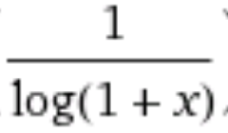
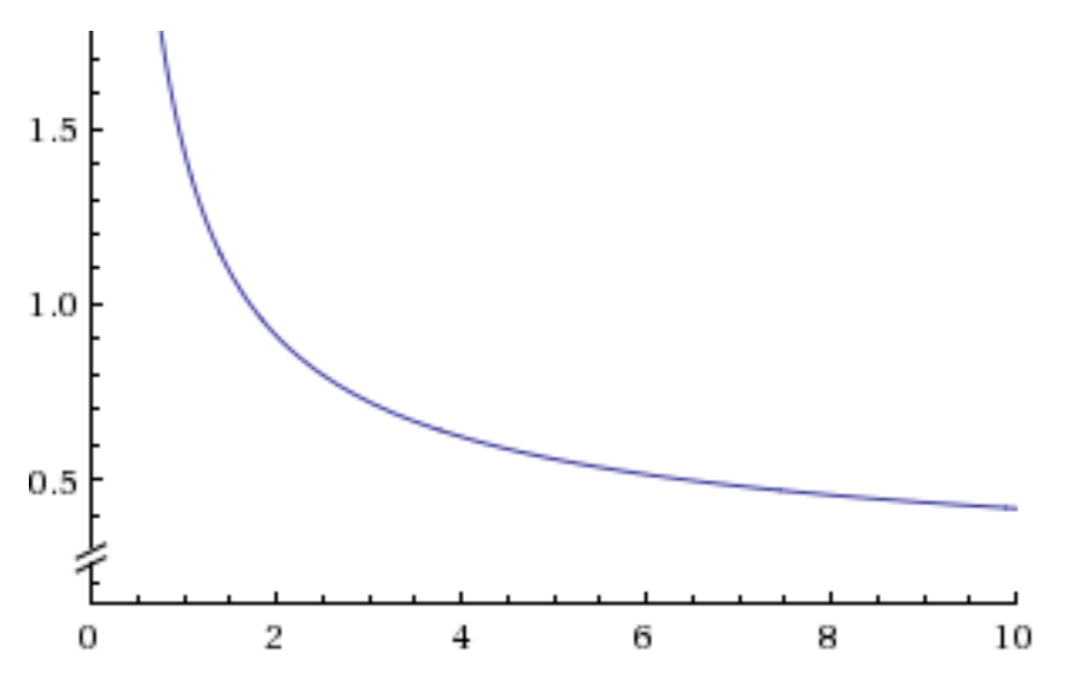
Dependency on ε₁
Notice the scale!
Bits per posting
Time in seconds

Slide 23
Dependency on ε₂
Here we go from O(n log n) to O(n)
Bits per posting
Time in seconds

Slide 24
Results on GOV2 and ClueWeb09
OR queries
AND queries
Notes:
More experiments in paper, code is available

Slide 25
Thanks for your attention!
Questions?

