Slide 1
Lecture #1
From 0-th order entropy compression
To k-th order entropy compression

Slide 2
Entropy (Shannon, 1948)
For a source S emitting symbols with probability p(s), the self information of s is:
bits
Lower probability → higher information
Entropy is the weighted average of i(s)
i(s)
H₀ = 0-th order empirical entropy (of a string, where p(s)=freq(s))

Slide 3
Performance
Compression ratio =
#bits in output / #bits in input
Compression performance: We relate entropy against compression ratio.
or

Slide 4
Huffman Code
Invented by Huffman as a class assignment in ‘50.
Used in most compression algorithms
  gzip, bzip, jpeg (as option), fax compression,…
Properties:
  Generates optimal prefix codes
  Fast to encode and decode
Good or
bad ?
We can prove that (n=|T|):
n H(T) ≤ |Huff(T)| < n H(T) + n
This means that it looses < 1 bit per symbol on avg !

Slide 5
Arithmetic coding
Given a text of n symbols it takes
nH₀ +2 bits vs. (nH₀ +n) bits of Huffman
Used in PPM, JPEG/MPEG (as option), …
More time costly than Huffman, but integer implementation is “not bad”.

Slide 6
Symbol interval
Assign each symbol to an interval [0, 1).
1.0
c = .3
0.7
b = .5
f(a) = .0, f(b) = .2, f(c) = .7
0.2
a = .2
0.0
e.g. the symbol interval for b is [.2,.7)

Slide 7
Encoding a sequence of symbols
Coding the sequence: bac
The final sequence interval is [.27,.3)
1.0
0.7
0.3
c = .3
c = .3
(0.7-0.2)*0.3=0.15
(0.3-0.2)*0.3=0.03
c = .3
0.7
0.55
0.27
b = .5
b = .5
(0.7-0.2)*0.5 = 0.25
b = .5
(0.3-0.2)*0.5 = 0.05
0.2
0.3
0.22
a = .2
a = .2
(0.7-0.2)*0.2=0.1
(0.3-0.2)*0.2=0.02
a = .2
0.0
0.2
0.2

Slide 8
The algorithm
To code a sequence of symbols:
0.3
P(c) = .3
0.27
P(b) = .5
0.22
P(a) = .2
0.2
Pick a number inside

Slide 9
Decoding Example
Decoding the number .49, knowing the input text to be decoded is of length 3:
The message is bbc.
1.0
0.7
0.55
c = .3
c = .3
c = .3
0.49
0.7
0.55
0.475
0.49
0.49
b = .5
b = .5
b = .5
0.2
0.3
0.35
a = .2
a = .2
a = .2
0.0
0.2
0.3

Slide 10
How do we encode that number?
Binary fractional representation:
FractionalEncode(x)
x = 2 * x
If x < 1 output 0, goto 1
x = x - 1; output 1, goto 1
2 * (1/3) = 2/3 < 1, output 0
2 * (2/3) = 4/3 > 1, output 1
→ 4/3 – 1 = 1/3
Incremental Generation

Slide 11
Which number do we encode?
Truncate the encoding to the first d = ⎡log (2/s_{n})⎤ bits
Truncation gets a smaller number… how much smaller?
l_{n} + s_{n}
l_{n} + s_{n}/2
Compression = Truncation
l_{n}
=0

Slide 12
Bound on code length
Theorem: For a text of length n, the Arithmetic encoder generates at most
⎡log₂ (2/s_{n})⎤ < 1 + log₂ 2/s_{n} = 1 + (1 - log₂ s_{n})
= 2 - log₂ (∏ _{i=1,n} p(T_{i}))
= 2 - ∑ _{i=1,n} (log₂ p(T_{i}))
= 2 - ∑_{σ=1,|Σ|} occ(σ) log p(σ)
= 2 + n * ∑_{σ=1,|Σ|} p(σ) log (1/p(σ))
= 2 + n H₀(T) bits
T = aaba
→ 3 * log p(a) + 1 * log p(b)
nH₀ + 0.02 n bits in practice
because of rounding

Slide 13
Where is the problem ?
Take the text T = a^{n} b^{n}, hence
H₀ = (1/2) log₂ 2 + (1/2) + log₂ 2 = 1 bit
so compression ratio would be 1/256 (ASCII)
or, no compression if a,b already encoded in 1 bit
Any Π(T), even random,
gets the same bound
We would like to deploy repetitions:
Wherever they occur
Whichever length they have

Slide 14
Data Compression
Can we use simpler
repetition-detectors?

Slide 15
Simple compressors: too simple?
Move-to-Front (MTF):
  As a freq-sorting approximator
  As a caching strategy
  As a compressor
Run-Length-Encoding (RLE):
  FAX compression

Slide 16
γ−code for integer encoding
Length-1
x > 0 and Length = ⎣log₂ x⎦ +1
e.g., 9 represented as <000,1001>.
γ−code for x takes 2 ⎣log₂ x⎦ +1 bits
(ie. factor of 2 from optimal)

Slide 17
Move to Front Coding
Transforms a char sequence into an integer sequence, that can then be var-length coded
Start with the list of symbols L=[a,b,c,d,…]
For each input symbol s
  output the position of s in L
  move s to the front of L
Properties:
It is a dynamic code, with memory (unlike Arithmetic)
X = 1^{n} 2^{n} 3^{n…} n^{n} → Huff = O(n² log n), MTF = O(n log n) + n²
In fact Huff takes log n bits per symbol being them equi-probable
MTF uses O(1) bits per symbol occurrence but first one O(log n)

Slide 18
Run Length Encoding (RLE)
If spatial locality is very high, then
abbbaacccca => (a,1),(b,3),(a,2),(c,4),(a,1)
In case of binary strings → just numbers and one bit
Properties:
It is a dynamic code, with memory (unlike Arithmetic)
X = 1^{n} 2^{n} 3^{n…} n^{n} →
Huff(X) = O(n² log n) > Rle(X) = O( n (1+log n) )
RLE uses log n bits per symb-block using γ-code per its length.

Slide 19
Data Compression
Burrows-Wheeler Transform

Slide 20
The big (unconscious) step...

Slide 21
The Burrows-Wheeler Transform (1994)
Let us given a text T = mississippi#
F
L
mississippi#
# mississipp i
ississippi#m
i #mississip p
ssissippi#mi
i ppi#missis s
sissippi#mis
i ssippi#mis s
issippi#miss
Sort the rows
i ssissippi# m
ssippi#missi
m ississippi #
T
sippi#missis
ippi#mississ
ppi#mississi
pi#mississip
i#mississipp
#mississippi
p i#mississi p
p pi#mississ i
s ippi#missi s
s issippi#mi s
s sippi#miss i
s sissippi#m i

Slide 22
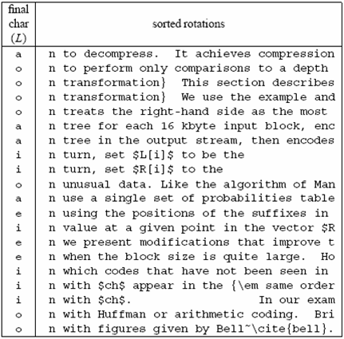
A famous example
Much
longer...

Slide 23
Compressing L seems promising...
Key observation:
L is locally homogeneous
L is highly compressible
Algorithm Bzip :
Move-to-Front coding of L
Run-Length coding
Statistical coder
Bzip vs. Gzip: 20% vs. 33%, but it is slower in (de)compression !

Slide 24
How to compute the BWT ?
SA
BWT matrix
L
We said that: L[i] precedes F[i] in T
12
11
8
5
2
1
10
9
7
4
6
3
#mississipp
i#mississip
ippi#missis
issippi#mis
ississippi#
mississippi
pi#mississi
ppi#mississ
sippi#missi
sissippi#mi
ssippi#miss
ssissippi#m
#mississipp
i#mississip
ippi#missis
issippi#mis
ississippi#
mississippi
pi#mississi
ppi#mississ
sippi#missi
sissippi#mi
ssippi#miss
ssissippi#m
i
p
s
s
m
#
p
i
s
s
i
i
L[3] = T[ 8 - 1 ]
Given SA and T, we have L[i] = T[SA[i]-1]
This is one of the main reasons for
the number of pubblications spurred
in ‘94-’10 on Suffix Array construction

Slide 25
A useful tool: L → F mapping
F
unknown
L
# mississipp i
i #mississip p
i ppi#missis s
i ssippi#mis s
i ssissippi# m
m ississippi #
Can we map L’s chars onto F’s chars ?
p i#mississi p
p pi#mississ i
s ippi#missi s
s issippi#mi s
s sippi#miss i
s sissippi#m i
... Need to distinguish equal chars...
Take two equal L’s chars
Rotate rightward their rows
Same relative order !!
Rank(char,pos) and Select(char,pos) key operations nowadays

Slide 26
The BWT is invertible
F
unknown
L
# mississipp i
Two key properties:
i #mississip p
1. LF-array maps L’s to F’s chars
i ppi#missis s
2. L[ i ] precedes F[ i ] in T
i ssippi#mis s
i ssissippi# m
Reconstruct T backward:
m ississippi #
p
p
i
T = .... #
i
p i#mississi p
p pi#mississ i
s ippi#missi s
s issippi#mi s
s sippi#miss i
s sissippi#m i
Several issues about efficiency in time and space

Slide 27
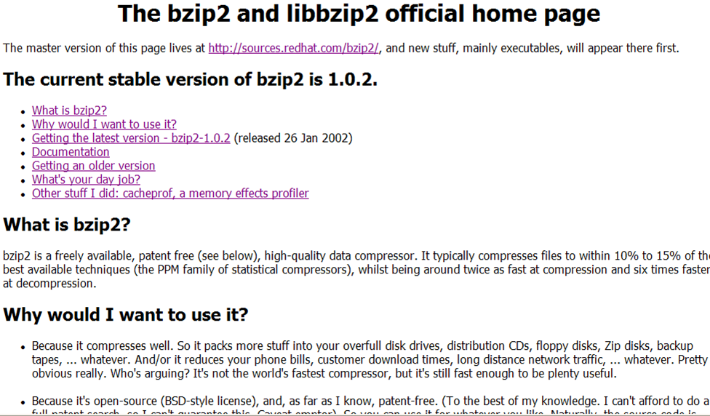
You find this in your Linux distribution

Slide 28
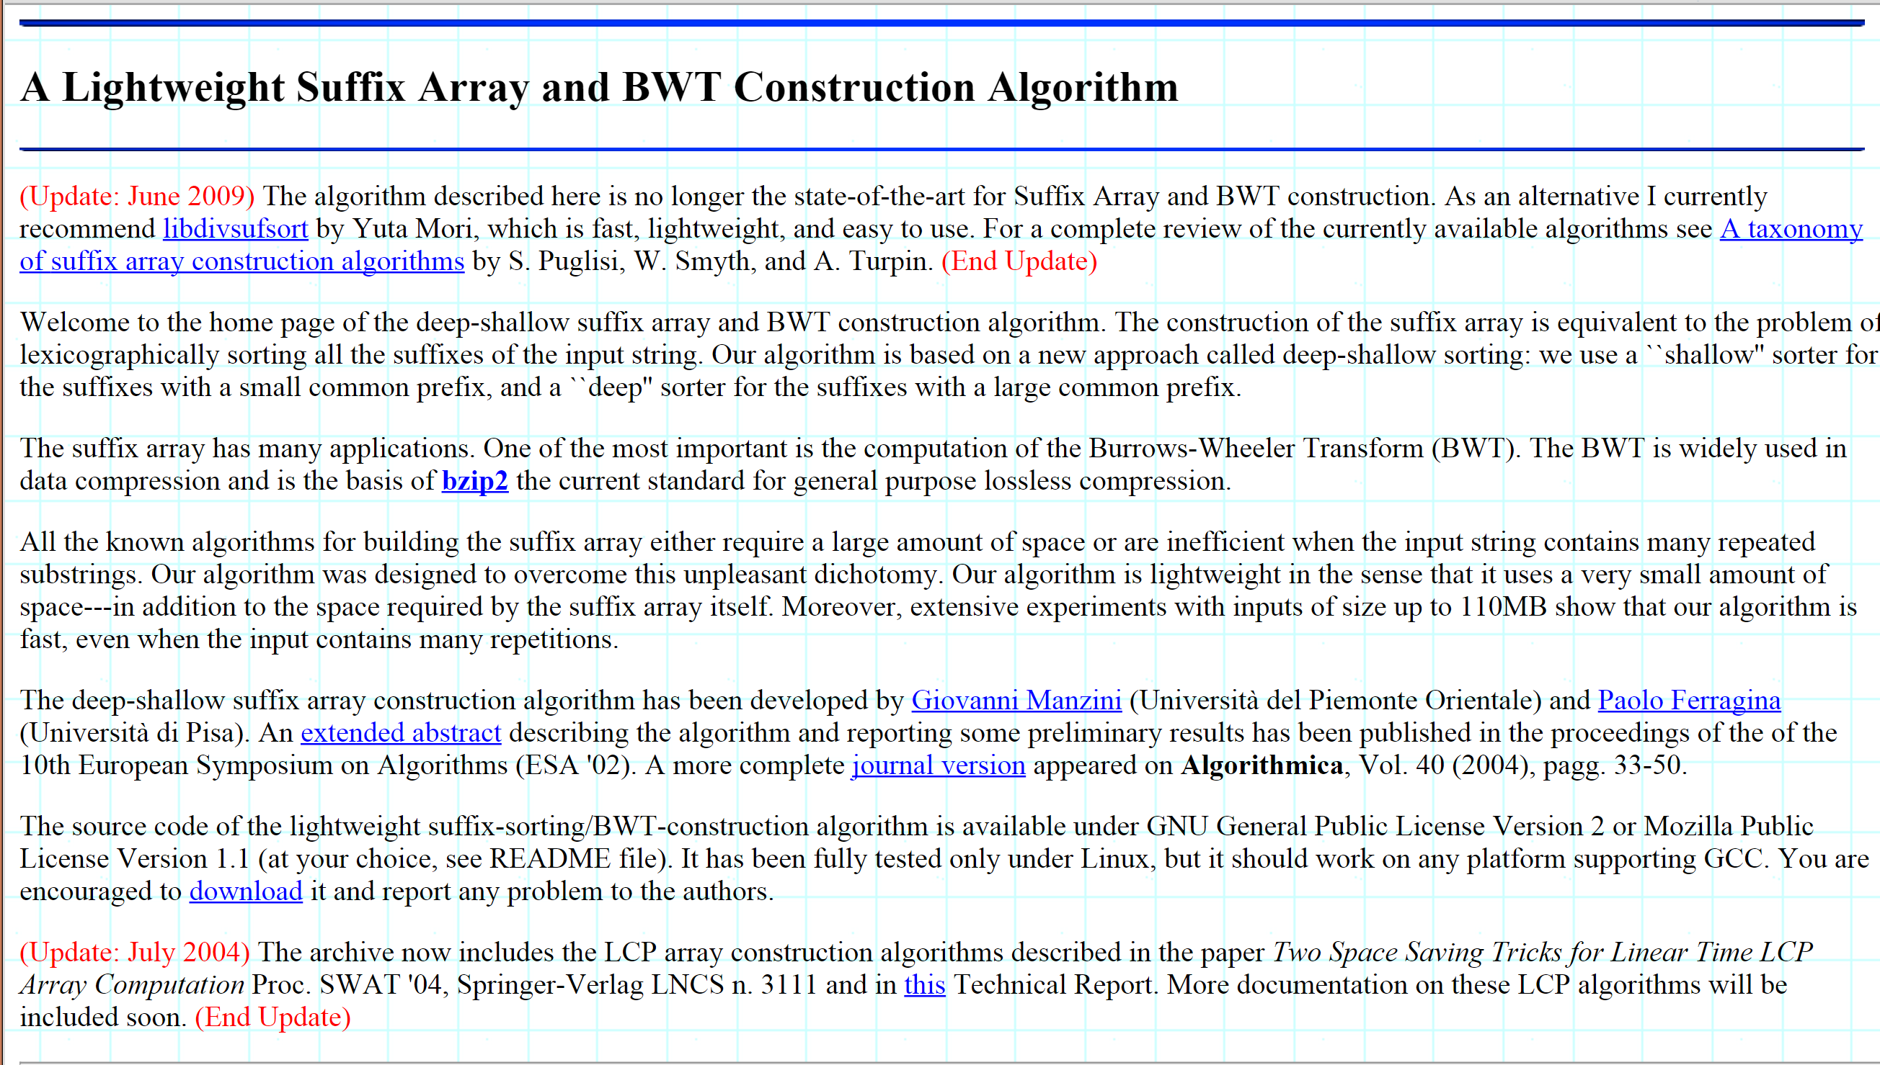
Suffix Array construction

Slide 29
Data Compression
What about
achieving high-order entropy ?

Slide 30
Recall that
Compression ratio =
#bits in output / #bits in input
Compression performance: We relate entropy against compression ratio.
or

Slide 31
The empirical entropy H_{k}
Use Huffman
or Arithmetic
How much is
this “operational” ?
Compress T up to H_{k}(T)
≅ compress each T[ω] up to its H₀
H_{k}(T)
= (1/|T|) ∑_{|ω|=k} | T[ω] | H₀(T[ω])
T[ω] = string of symbols that precede the substring ω in T
Example: Given T = “mississippi”, we have
T[“is”] = ms
The distinct substrings ω for H₂(T) are
{i_ (1,p), ip (1,s), is (2,ms), pi (1,p), pp (1,i), mi (1,_), si (2,ss), ss (2,ii)}
H₂(T) = (1/11) * [1 * H₀(p) + 1 * H₀(s) + 2 * H₀(ms) + 1 * H₀(p) + …]

Slide 32
BWT versus H_{k}
Bwt(T)
#mississipp i
Symbols preceding ω
i#mississip p
ippi#missis s
but this is a permutation of T[ω]
ω
issippi#mis s
ississippi# m
 H₀ does not change !!!
mississippi #
pi#mississi p
ppi#mississ i
sippi#missi s
sissippi#mi s
ssippi#miss i
ssissippi#m i
Compressing pieces in BWT up to
their H_{0 ,} we achieve H₂(T)
We have a workable
way to approximate H_{k}
via bwt-partitions
T = m i s s i s s i p p i #
1 2 3 4 5 6 7 8 9 10 11 12
|T[ω]| * H₀(T[ω])
∑_{|ω|=2}
T[ω=is] = “ms”
|T| H₂(T) =

Slide 33
Operationally…
Let C be a compressor achieving H₀
  Arithmetic(α) ≤ |α| H₀(α) + 2 bits
An interesting approach:
  Compute bwt(T), and get a partition Π induced by k
  Apply C on each piece of Π
The space is
  The partition depends on k
  The approximation of H_{k}(T) depends on C and g_{k}
= ∑_{|ω|=k} |C(T[ω])| ≤ ∑_{|ω|=k} ( |T[ω]| H₀ (T[ω]) + 2 )
≤ |T| H_{k} (T) + 2 g_{k}
Compression booster
[J. ACM ‘05]
Optimal partition Π → shortest |C(Π)|
O(n) time
H_{k}-bound holds simultaneously ∀k ≥ 0

