Slide 1
Text Indexing
The Suffix Array

Slide 2
Basic notation and facts
Pattern P occurs at position i of T
iff P is a prefix of the i-th suffix of T (ie. T[i,N])
i
P
T
T[i,N]
Occurrences of P in T = All suffixes of T having P as a prefix
T = mississippi
mississippi
P = si
4,7
Reduction
SUF(T) = Sorted set of suffixes of T
From substring search
To prefix search

Slide 3
The Suffix Array
Prop 1. All suffixes in SUF(T) having prefix P are contiguous.
Prop 2. Starting position is the lexicographic one of P.
Θ(N²) space
5
T = mississippi#
T = mississippi#
SA
SUF(T)
12
11
8
5
2
1
10
9
7
4
6
3
#
i#
ippi#
issippi#
ississippi#
mississippi#
pi#
ppi#
sippi#
sissippi#
ssippi#
ssissippi#
suffix pointer
P=si
Suffix Array
SA: Θ(N log₂ N) bits
Text T: N chars
⇨ In practice, a total of 5N bytes

Slide 4
Searching a pattern
Indirected binary search on SA: O(p) time per suffix cmp
T = mississippi#
SA
12
11
8
5
2
1
10
9
7
4
6
3
P is larger
2 accesses per step
P = si

Slide 5
Searching a pattern
Indirected binary search on SA: O(p) time per suffix cmp
T = mississippi#
SA
12
11
8
5
2
1
10
9
7
4
6
3
P is smaller
Suffix Array search
O(log₂ N) binary-search steps
Each step takes O(p) char cmp
⇨ overall, O(p log₂ N) time
P = si

Slide 6
Listing of the occurrences
T = mississippi#
4 7
SA
Suffix Array search
O (p * log₂ N + occ) time
can be reduced…
12
11
8
5
2
1
10
9
7
4
6
3
12
11
8
5
2
1
10
9
7
4
6
3
12
11
8
5
2
1
10
9
7
4
6
3
where # < Σ < $
si#
occ=2
sippi
sissippi
si$

Slide 7
Text mining
T = mississippi#
4 6 7 9
Lcp
SA
0
0
1
4
0
0
1
0
2
1
3
12
11
8
5
2
1
10
9
7
4
6
3
issippi
ississippi
How long is the common prefix between T[i,...] and T[j,...] ?
Min of the subarray Lcp[h,k] s.t. SA[h]=i and SA[k]=j.
Does it exist a repeated substring of length ≥ L ?
Search for Lcp[i] ≥ L
Does it exist a substring of length ≥ L occurring ≥ C times ?
Search for Lcp[i,i+C-2] whose entries are ≥ L

Slide 8
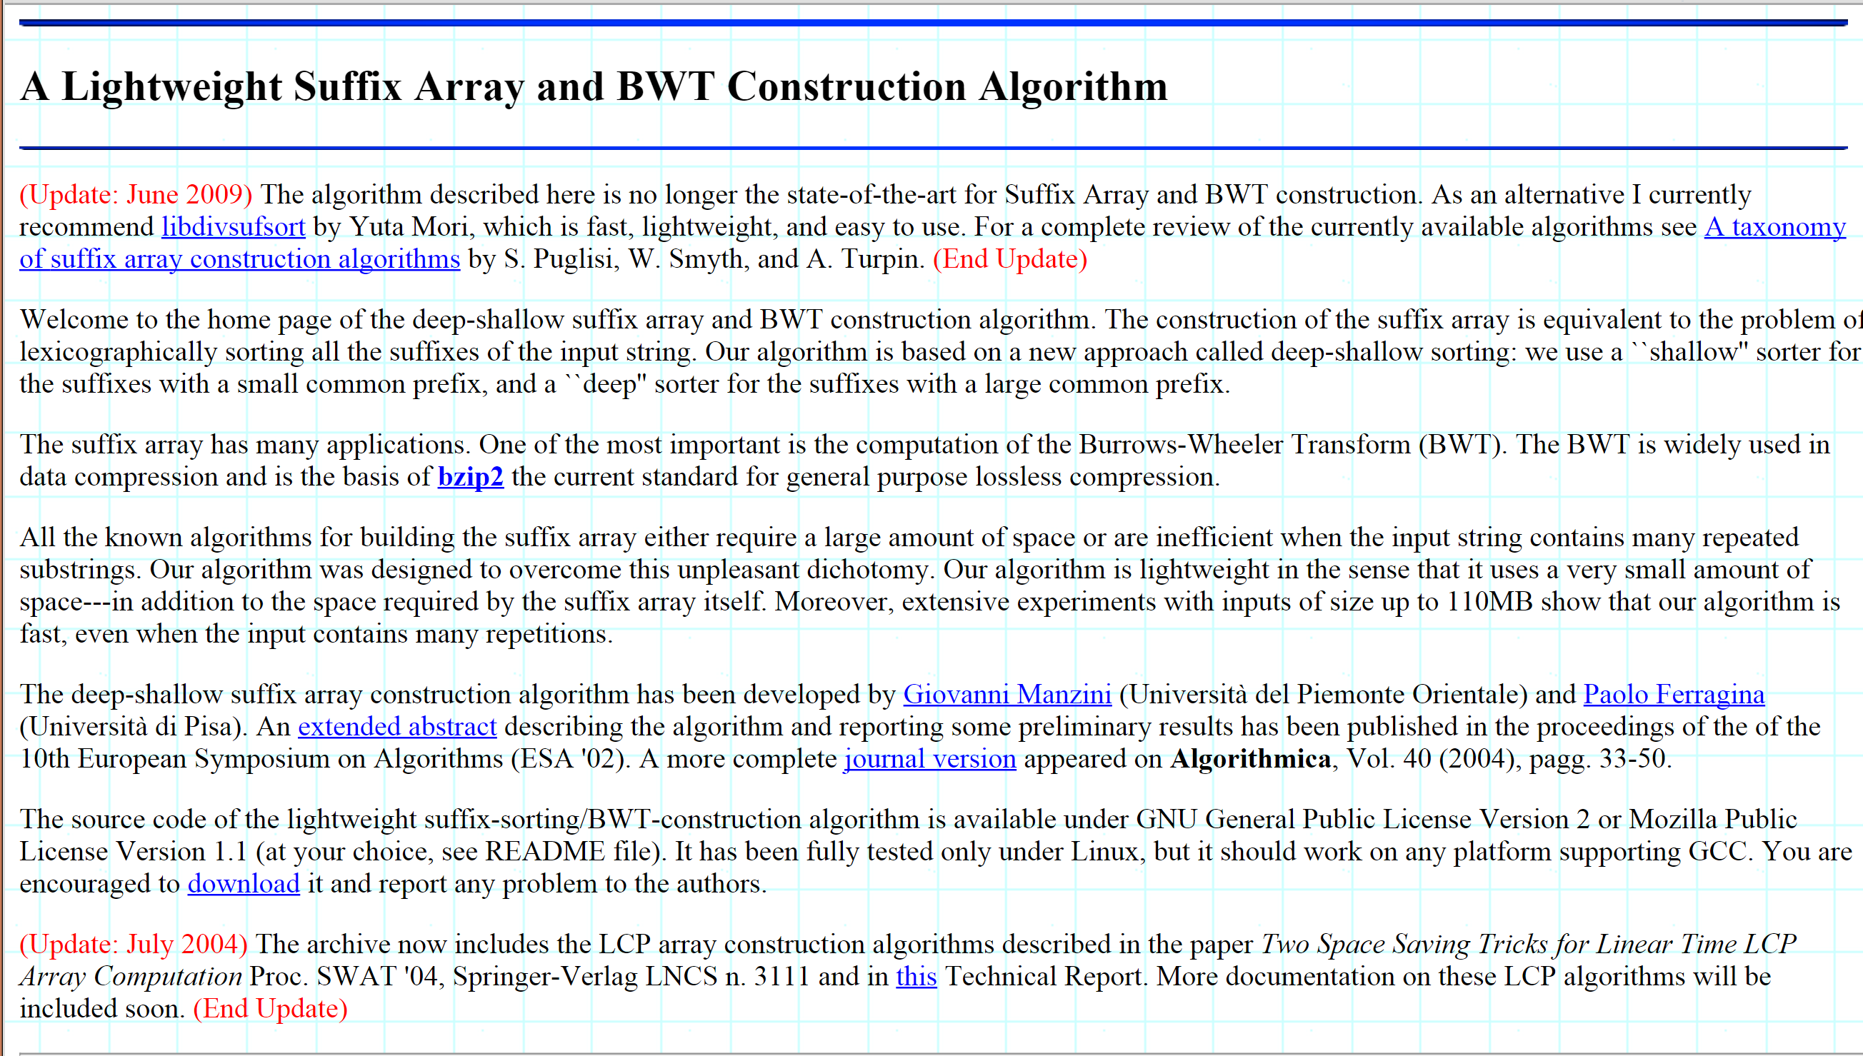
Giovanni Manzini’s page

Slide 9
Compressed Indexing
What about
accessing or searching
compressed data?

Slide 10
Decompress any substring
F
unknown
L
Recall that LF-mapping means:
# mississipp i
k-th occurrence of σ in L
corresponds to
k-th occurrence of σ in F
i #mississip p
i ppi#missis s
i ssippi#mis s
i ssissippi# m
T = mississippi#
m ississippi #
m
i
s
1 4 8 12
p i#mississi p
p pi#mississ i
s ippi#missi s
s issippi#mi s
s sippi#miss i
s sissippi#m i
sampling step is 4
Trade-off between space (n log n/S bits) and decompression time of an L-long substring (S+ L time) due to the sampling step S
You can reconstruct any substring
backward IF you know the row of
its last character
How do we know where to start ? Keep sampled positions

Slide 11
Substring search in T (Count the pattern occurrences)
P[ j ]
F
P = si
# 1
i 2
m 6
p 7
s 9
Available info
First step
L
unknown
#mississipp
i#mississip
ippi#missis
issippi#mis
ississippi#
mississippi
pi#mississi
ppi#mississ
sippi#missi
sissippi#mi
ssippi#miss
ssissippi#m
i
p
s
s
m
#
p
i
s
s
i
i
rows prefixed
by char “i”
fr
s
s
lr
Inductive step: Given fr,lr for P[j+1,p]
mississippi
Take c=P[j]
Find the first c in L[fr, lr]
Find the last c in L[fr, lr]
fr
L-to-F mapping of these chars
occ=2
[lr-fr+1]
lr
Rank is enough

Slide 12
