Slide 1
Random access to arrays of variable-length items
Paolo Ferragina
Dipartimento di Informatica
Università di Pisa

Slide 2
A basic problem !
T
Abaco#Battle#Car#Cold#Cod#Defense#Google#Yahoo#....
Array of pointers
  (log m) bits per string = (n log m) bits= 32 n bits.
  We could drop the separating NULL
Independent of string-length distribution
  It is effective for few strings
  It is bad for medium/large sets of strings

Slide 3
A basic problem !
T
Abaco#Battle#Car#Cold#Cod#Defense#Google#Yahoo#....
X
AbacoBattleCarColdCodDefenseGoogleYahoo....
B
10000100000100100010010000001000010000....
A
10#2#5#6#20#31#3#3#....
We could
drop msb
X
1010101011101010111111111....
B
1000101001001000100001010....
We aim at achieving ≈ n log(m/n) bits ≤ n log m

Slide 4
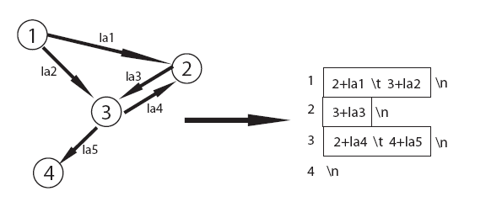
Another textDB: Labeled Graph

Slide 5
Rank/Select
Wish to index the bit vector B (possibly compressed).
Select₁(3) = 8
B
00101001010101011111110000011010101....
Rank₁(6) = 2
m = |B|
n = #1
Rank_{b}(i) = number of b in B[1,i]
Select_{b}(i) = position of the i-th b in B
Do exist data structures that solve this problem in
O(1) query time and very small extra space (i.e. +o(m) bits)

Slide 6
The Bit-Vector Index: B + o(m)
m = |B|
n = #1s
Goal. B is read-only, and the additional index takes o(m) bits.
Rank
B
00101001010101011 1111100010110101 0101010111000....
Z
8
18
4 5 8
block
pos
#1
(absolute) Rank₁
z
0000 | 1 | 0
.... | ... | ...
1011 | 2 | 1
....
(bucket-relative) Rank₁
Setting Z = poly(log m) and z=(1/2) log m:
  Extra space is + (m/Z) log m + (m/z) log Z + o(m)
    + O(m loglog m / log m) = o(m) bits
  Rank time is O(1)
  Term o(m) is crucial in practice, B is untouched (not compressed)

Slide 7
The Bit-Vector Index
m = |B|
n = #1s
B
0010100101010101111111000001101010101010111001....
size r is variable  k consecutive 1s
Sparse case: If r > k² store explicitly the position of the k 1s
Dense case: k ≤ r ≤ k², recurse... One level is enough!!
... still need a table of size o(m).
Setting k ≈ polylog m
  Extra space is + o(m), and B is not touched!
  Select time is O(1)
There exists a Bit-Vector Index
taking o(m) extra bits
and constant time for Rank/Select.
B is read-only!

Slide 8

Elias-Fano index&compress
If w = log (m/n) and z = log n, where m = |B| and n = #1 then
L takes n w = n log (m/n) bits
H takes n 1s + n 0s = 2n bits
z = 3, w=2
0 1 2 3 4 5 6 7
(Select₁ on H)
In unary
Select₁(i) on B → uses L and (Select₁(H,i) – i) in +o(n) space
Actually you can do binary search over B, but compressed !

Slide 9

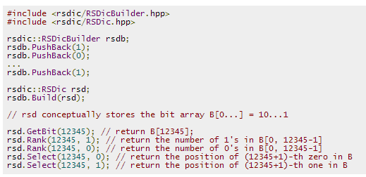
If you wish to play with Rank and Select
m/10 + n log m/n
Rank in 0.4 μsec, Select in < 1 μsec
vs 32n bits of explicit pointers

Slide 10
Generalised Rank and Select
Rank(c,i) = #c in L[1,i]
Select(c,i) = position of the i-th c in L
L = a b a a a c b c d a b e c d ...
Select( a , 2 ) = 3
Rank( a , 7 ) = 4

Slide 11
Generalised Rank and Select
If Σ is small (i.e. constant)
  Build binary Rank data structure per symbol of Σ
  Rank takes O(1) time and o(|T|) space [even entropy bounded]
If Σ is large (words ?)
  Need a smarter solution: Wavelet Tree data structure
Algorithmic reduction:
>> Reduce Rank&Select over arbitrary strings
... to Rank&Select over binary strings

Slide 12
The Wavelet Tree
abracadabra
Alphabetic
Tree
a
b
r
c
d

Slide 13
The Wavelet Tree
abracadabra
abaaaba
rcdr
cd
a
b
r
aaaaa
bb
rr
c
d
You do not need the
leaves because of {0,1}
in their parent
c
d

Slide 14
The Wavelet Tree
abracadabra
00101010010
0100010
abaaaba
rcdr
1001
01
cd
a
b
r
Total space may be estimated as
O(|Σ| log |Σ|) bits
c
d
Fact. Given the alphabetic tree and the binary strings,
we can recover the original string !!

Slide 15
The Wavelet Tree
Reduce
to
right
symbols
Rank(c,8)
abracadabra
00101010010
Rank(c,3)
abaaaba
0100010
rcdr
1001
Rank(c,2)
cd
01
Reduce
to
left
symbols
a
b
r
c
d

Slide 16
The Wavelet Tree
Select is
similar
Rank(c,8)
Right move
=
Rank₁
abracadabra
00101010010
Rank₁(8)=3
abaaaba
0100010
rcdr
1001
Rank₀(3)=2
Rank₀(2)=1
cd
01
Left move
=
Rank₀
a
b
r
Left move
=
Rank₀
c
d
Generalised R&S → Binary R&S with log |Σ| slowdown

Slide 17
Generalised Rank and Select
If Σ is large the Wavelet Tree data structure guarantees
Rank and Select take o(log | Σ |) time and
nH₀ + n bits of space (like Huffman)
Other bounds are possible, with d-ary trees:
log_{d} | Σ | time and n log | Σ | + o(n) bits

Slide 18
WT vs 2D-range search
WT + Rank&Select
solves 2D-range
16
14
12
10
8
6
4
2
Sort by y
Write x
y-sort
[5,12]
T
4 10
7 13 1 14 6 11 10
[4,10]
7 1 6
13 14 11 10
6 7
10 11
6
7
10
11
5
12
2 4 6 8 10 12 14 16
x-sort
[4,10]
[5,12] x
T = 2 3 8 7 13 1 14 6 11 10 16 15 12 9 5 4

Slide 19
String search vs 2D-range search
T = a b r a c a d r a b r a
1 2 3 4 5 6 7 8 9 10 11 12
Pos SA suffix point
12 a 1,12
9 abra 2,9
1 abracadabra 3,1
4 4 acadrabra 4,4
5 6 adrabra 5,6
6 10 bra 6,10
7 2 bracadabra 7,2
8 5 cadabra 8,5
9 7 dabra 9,7
10 11 ra 10,11
11 8 rabra 11,8
12 3 racadabra 12,3
Build the suffix array for T
For each T[i,n] at position SA[j] build a point <j,i>
Search for P[1,p] (=ra) in T[s,e] (T[3,8])
Search P in the Suffix Array, and find the range [L,R] of suffixes which are prefixed by P (= [10,12])
Perform a 2D-range search in [L, R] x [s, e-p+1]
[10,12] x [3, 7=8-2+1] → (12,3)
Prefix search over multi-attributes

Slide 20
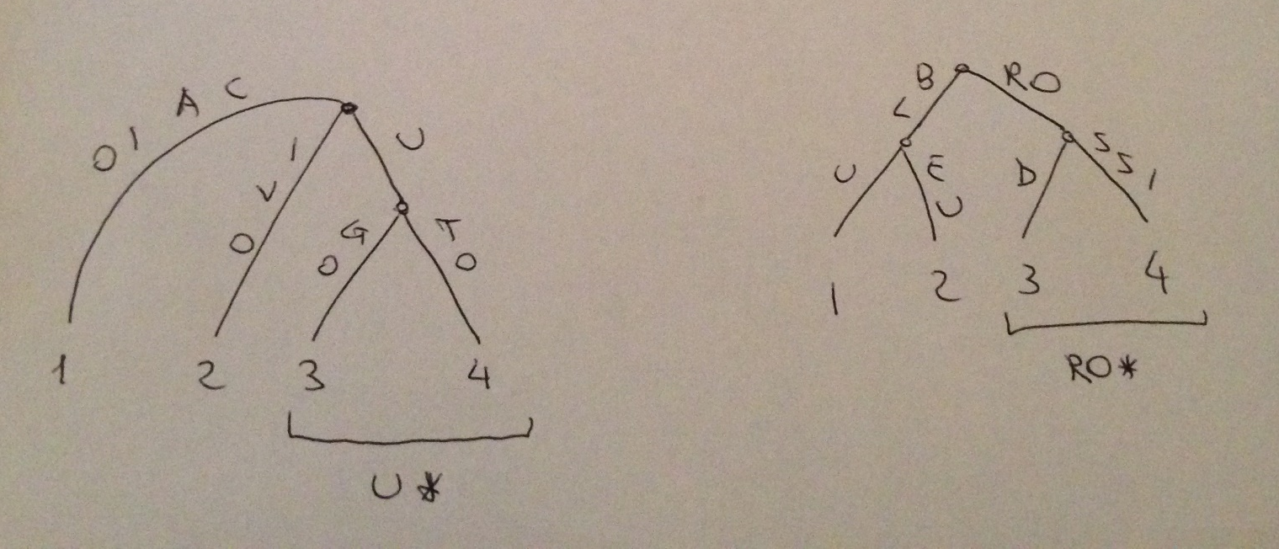
Prefix search vs 2D-range search
Given a dictionary of records <s1[i], s2[i]>
Construct two tries, one for s1’s and one for s2’s strings
Number the leaves from left to right
<ugo, rossi>, <uto, blu>
<caio, rod>, <ivo, bleu>
A

Slide 21
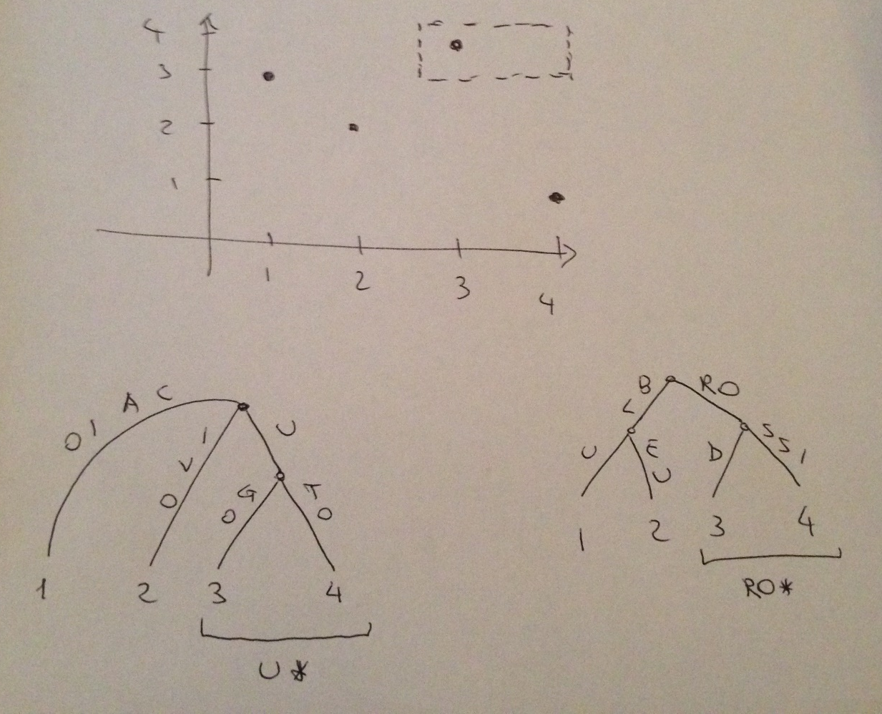
Prefix search vs 2D-range search
For every record, create a 2D-point <a,b>
Two-prefix searches <P,Q>= <u*, ro*>
Search P & Q in the tries
Identify the range of leaves (ints) delimited by P and Q
Perform a 2D-range search over the ranges: [P_{L}, P_{R}] x [Q_{L}, Q_{R}]
A
<ugo, rossi>, <uto, bla>
<caio, rod>, <ivo, bleu>

